Slide 1


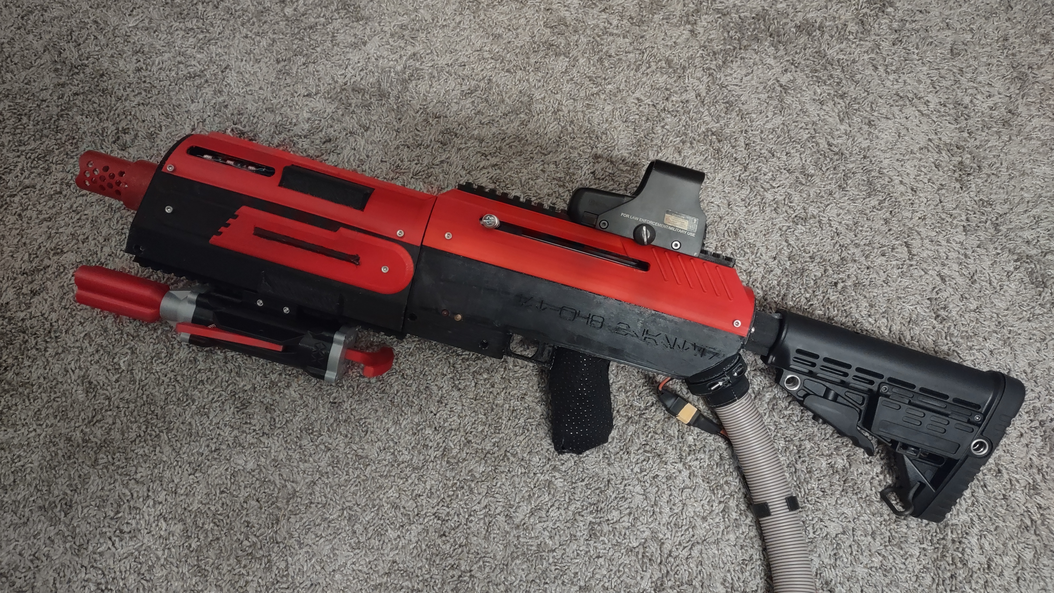
RBT173 Final Presentation
ST-W48 Blaster
Tyler Widener

Slide 2
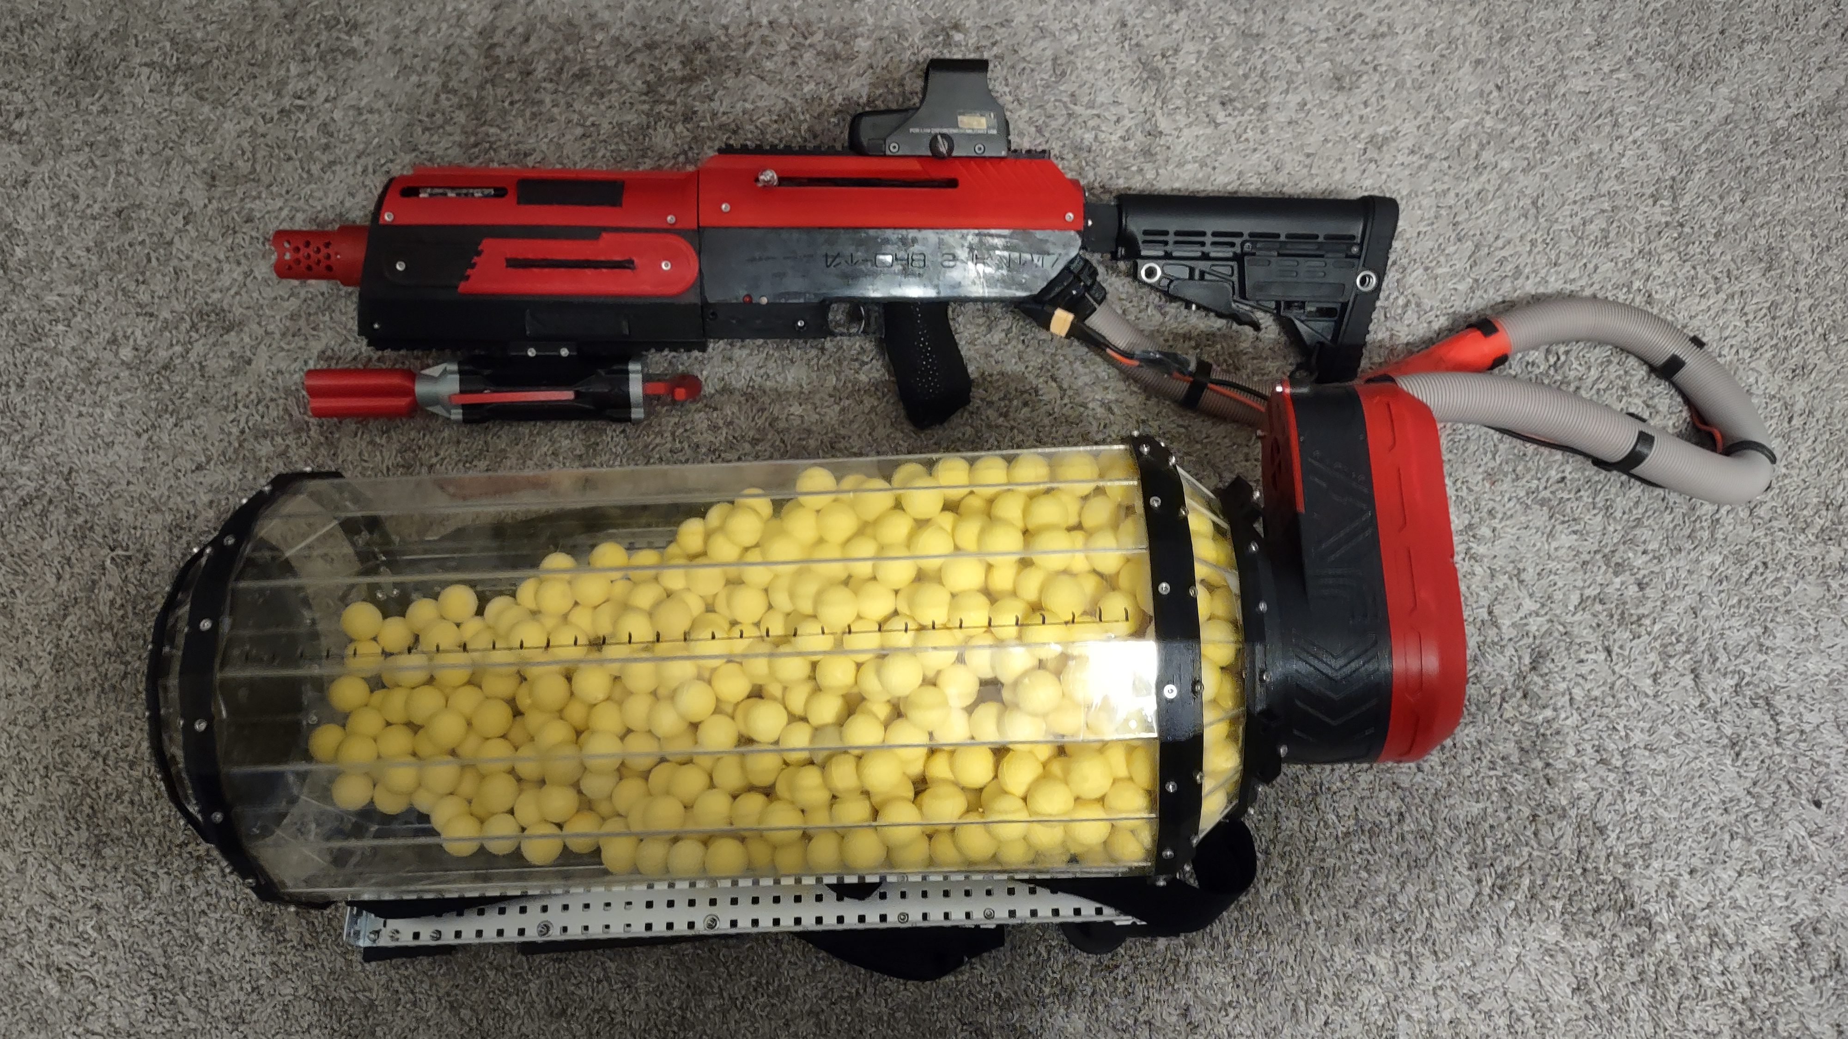
ST-W48 Blaster
Backpack Fed Nerf Blaster
Holding Capacity: 2000 Rival Balls
Fire Rate: 15/sec
FPS (Feet per second): ~100
Arduino Nano Overheat Mechanic

Slide 3
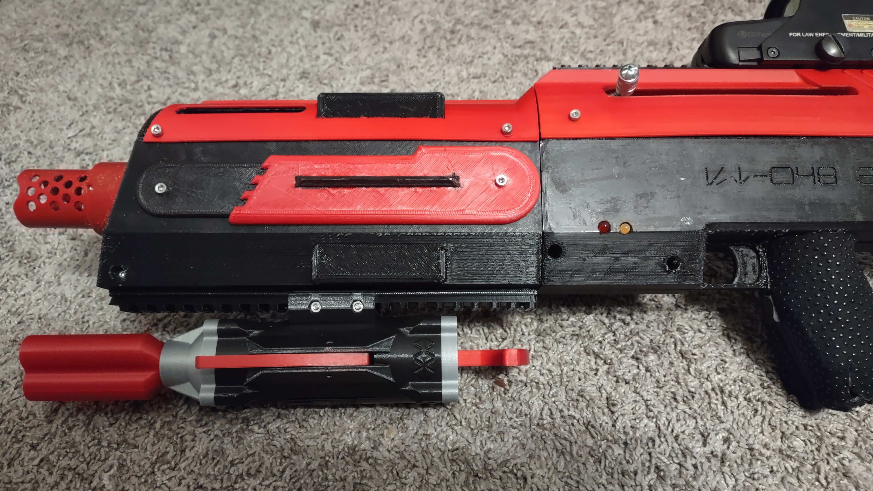
Operation:
Charging Handle
Primary Trigger
Secondary Trigger
Diagnostic LEDs
1
4
2
3

Slide 4
1
Secondary Trigger feeds ammunition and starts flywheels.
Primary Trigger fires darts.
4
2
3

Slide 5
1
Red LED lights when overheated.
Pull charging handle when yellow LED is lit to reset.
4
2
3

Slide 6
1
Pull charging handle before overheat to reset early.
4
2
3

Slide 7
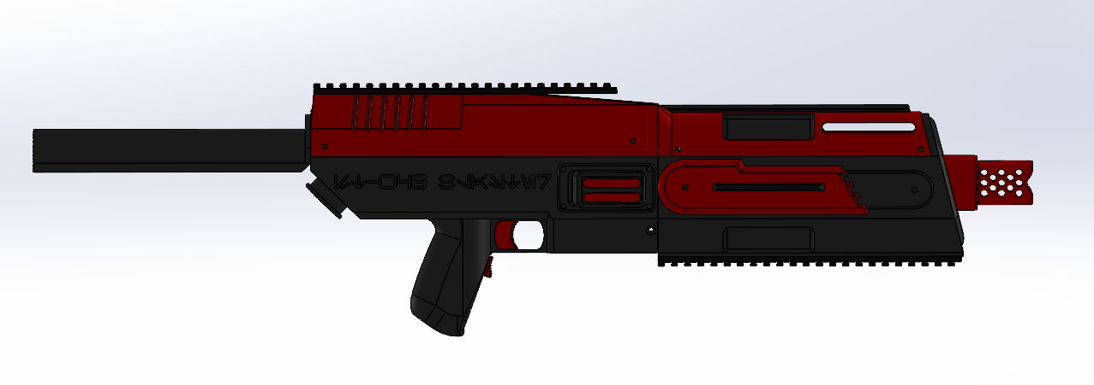
Solidworks Design

Slide 8
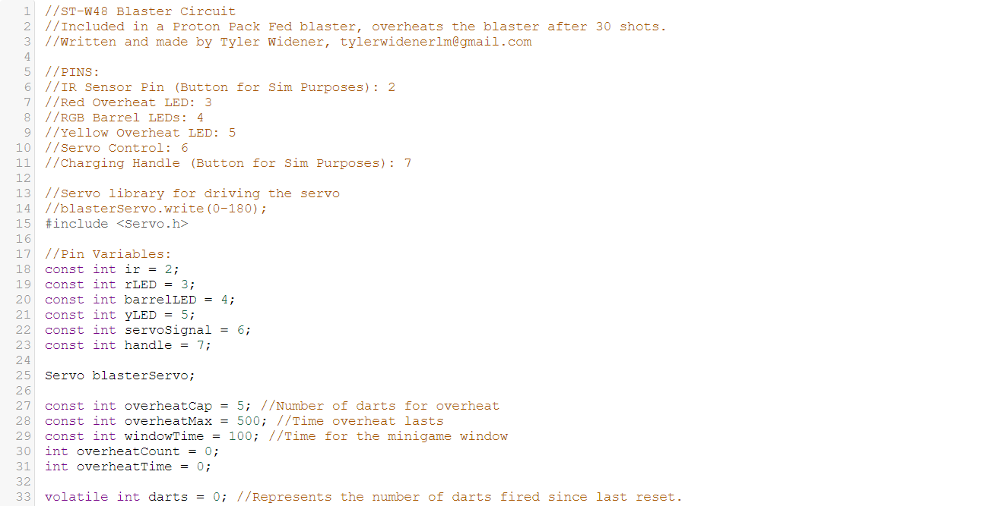
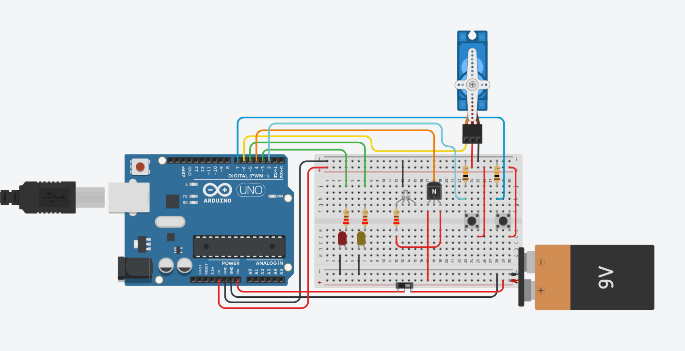
Tinkercad
Programming / Circuit

Slide 9
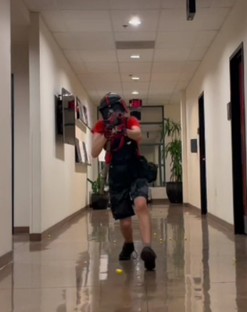
Completed Build / Game Testing

Slide 10
Live Demo

Slide 11
Final Notes
End BOM worth: ~$500
Custom Rucksack Style Frame
Speaker and Ergonomic Changes in the future.

Slide 12
ST-W48 Blaster
Tyler Widener

